Slide 1
Monthly Report
CMG, Arduino, MATLAB I/O

Slide 2
Arduino IDE
Learnt about basics of Arduino and how to program on Arduino IDE.
Learnt to use blinking LED on Arduino board.
Used Arduino IDE to operate a display of LEDs, temperature sensor, gyro sensor, motion sensor, etc.

Slide 3
MATLAB I/O
Installed MATLAB I/O add-on to MATLAB.
Used this library to operate Arduino via MATLAB.
Used this library to operate LEDs in different modes on arduino

Slide 4

Inverted Pendulum CMG Robot
Built a simple inverted pendulum robot using gyro sensor for self-balancing.
Currently trying to balance the robot using Arduino IDE.
Varying the parameters ‘θ, θ˙, x,$\dot{x}$’ to get the robot to balance itself

Slide 5
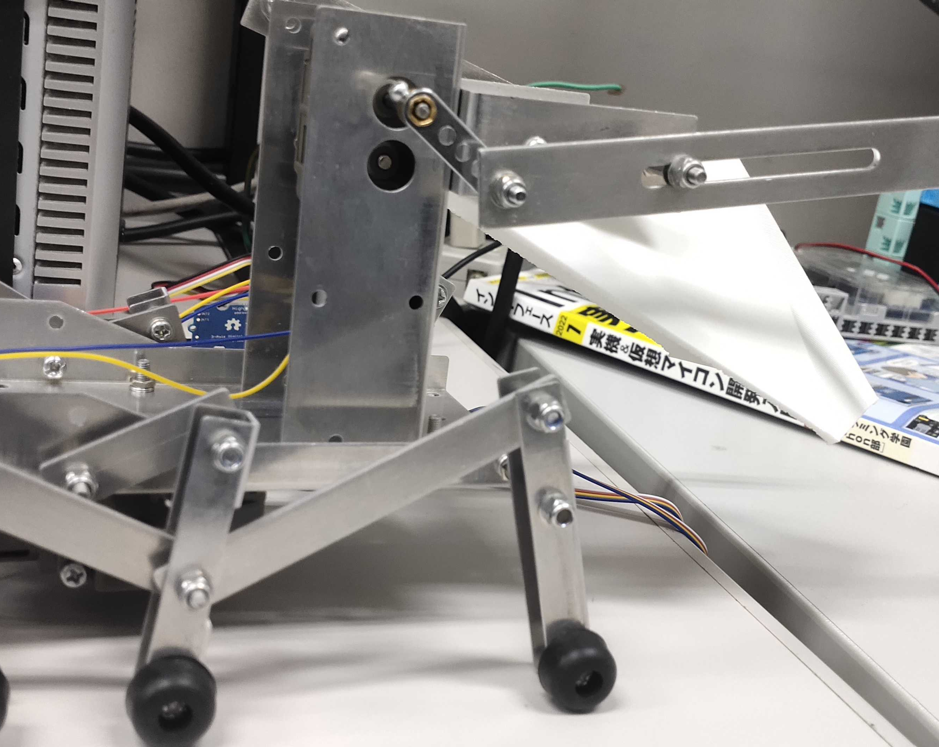
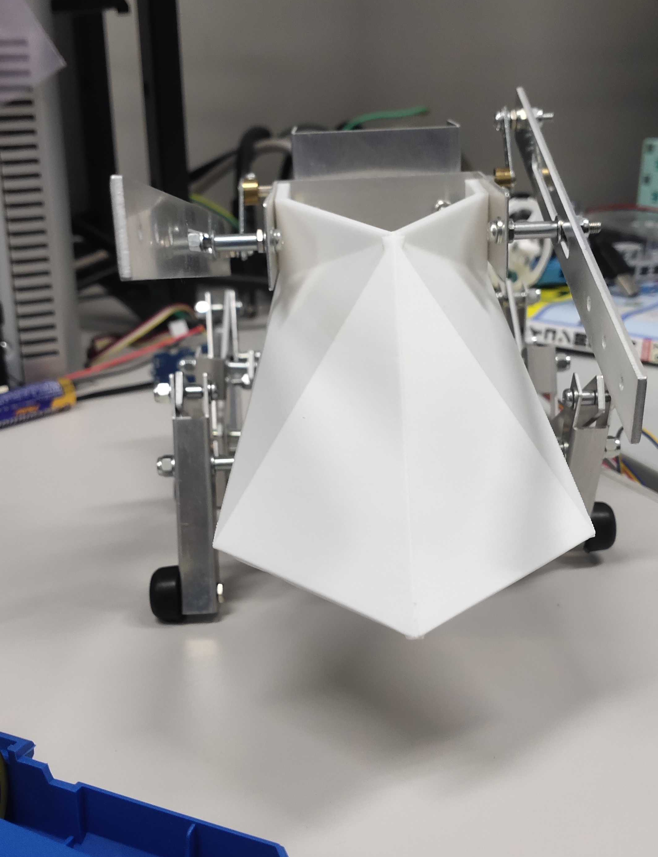
Customized Boxer Robot
Built a customized boxer robot.
To demonstrate to first year UG students for their project.

Slide 6
Future Plans
To get the inverted pendulum balanced on its own.
Use MATLAB library to operate the inverted pendulum.
Then finally balancing it without using USB cables.

